Slide 1

Hong Kong Trade Development Council
End User Training – Payables (Invoice)
27 AUG 2020

Slide 2

Agenda
Create Invoices
Create/ Search Invoice Batch
Create Direct Invoice
Create PO Invoice
Q&A

Slide 3
Create Invoice
Create/ Search Invoice Batch

Slide 4
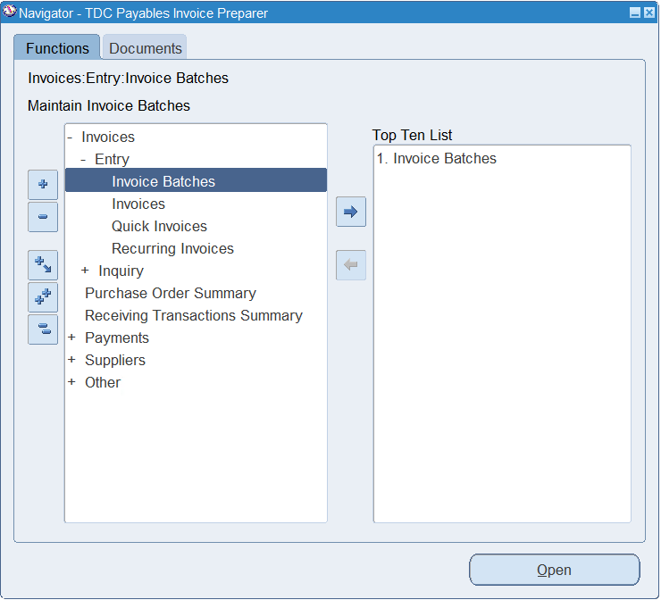
Create Invoice
Create Invoice Batch (1/2)
New fields will be available for entering Project, Task, Expenditure Type or Revenue Event Type when entering project related invoice lines.
Responsibility:
TDC Payables Invoice Preparer
TDC Payables Invoice Preparer (ES)
TDC Payables Invoice Preparer (JBCC)
Invoices > Entry > Invoice Batches
1

Slide 5
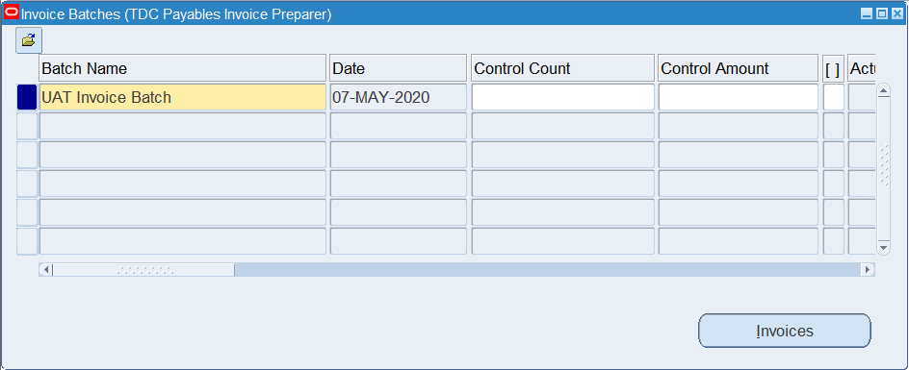
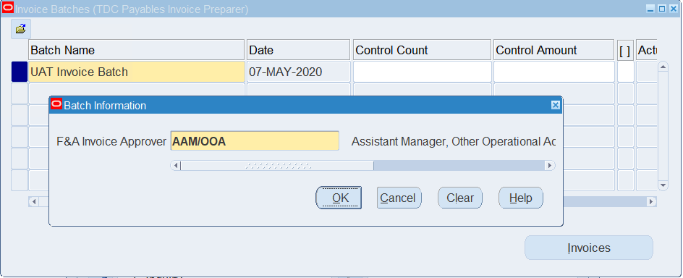
Create Invoice
Create Invoice Batch (2/2)
Enter invoice batch name.
Click “DFF”
Select “F&A Invoice Approver”
Click “OK”
Click “Invoices” button to start entering invoices in this batch.
2
3
4
5
6

Slide 6
Create Invoice
Search Invoice Batch (1/2)
Responsibility:
TDC Payables Invoice Preparer
TDC Payables Invoice Preparer (ES)
TDC Payables Invoice Preparer (JBCC)
Invoices > Entry > Invoice Batches
1

Slide 7
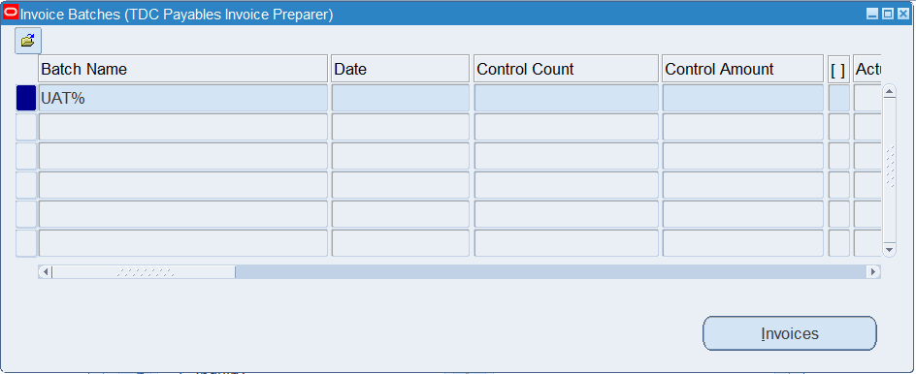
Create Invoice
Search Invoice Batch (2/2)
Press key “F11”
Enter field value in “Batch Name” field for record searching. (Note: wild card character is “%”, e.g. UAT%)
Press key “Ctrl” + “F11”
3

Slide 8
Create Invoice
Create Direct Invoice

Slide 9
Create Invoice
Create Direct Invoice (1/11)
Responsibility:
TDC Payables Invoice Preparer
TDC Payables Invoice Preparer (ES)
TDC Payables Invoice Preparer (JBCC)
Invoices > Entry > Invoice Batches
1

Slide 10
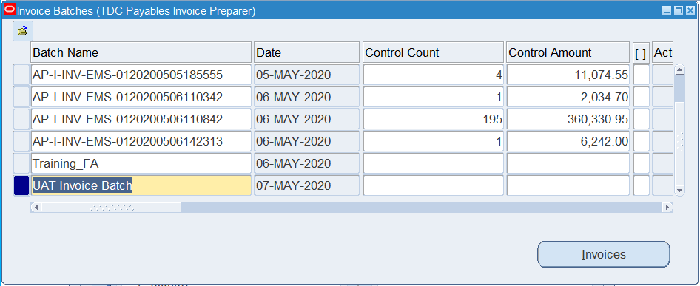
Create Invoice
Create Direct Invoice (2/11)
Create/ Search an invoice batch.
Click Invoices
2
3

Slide 11

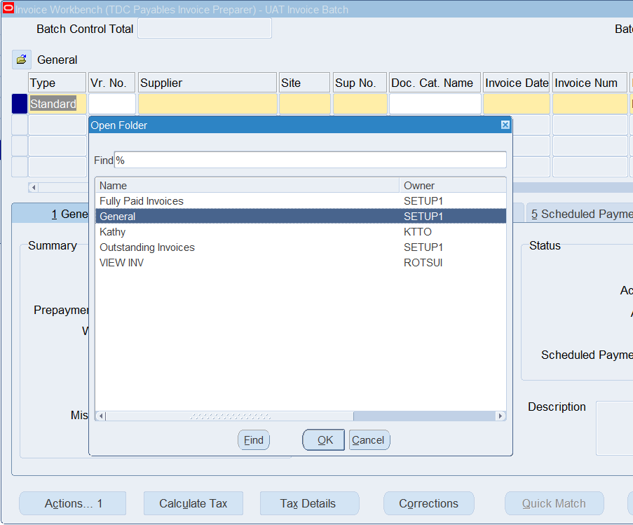
Create Invoice
Create Direct Invoice (3/11)
Click “Add Record” icon to add another invoice (If there is no existing invoice in the invoice batch, skip the following tasks and directly perform tasks in Step (7).
4
Click “Folder” and select “General”
Click “Ok
5
6

Slide 12
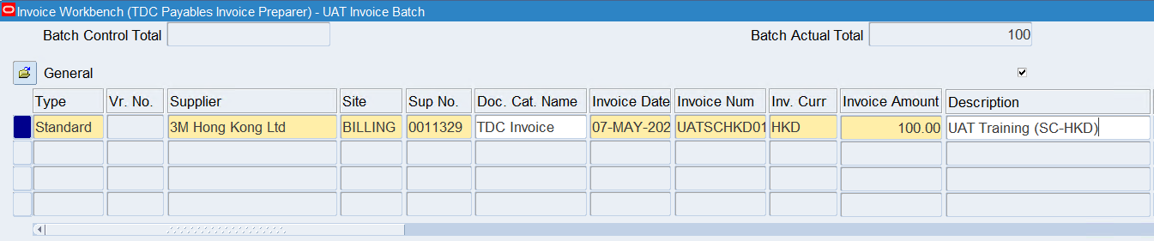
Create Invoice
Create Direct Invoice (4/11)
Select the “Supplier” or “Supplier No.”
Select the “Supplier Site” of the supplier.
Select “Doc. Cat. Name”
Enter “Invoice Date”, “Invoice Num”, Enter “Inv. Curr”, “Invoice Amount”, “Description”
7
8
7
9
10

Slide 13
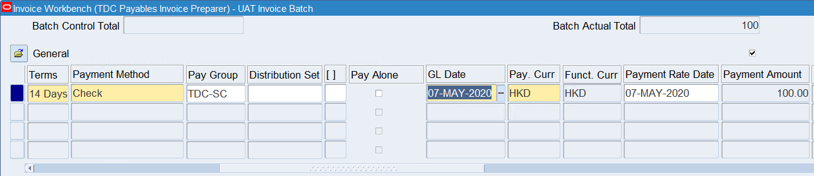
Create Invoice
Create Direct Invoice (5/11)
Scroll to the right.
Overwrite the default “Payment Terms” and “Payment Method” of this supplier site if appropriate.
Enter “Pay Group”
Check the Pay Alone checkbox to issue a separate payment for this invoice (i.e. not paid with other invoices of the same supplier site).
Update the GL Date if the default value (i.e. invoice date) is not suitable.
11
12
13
14

Slide 14
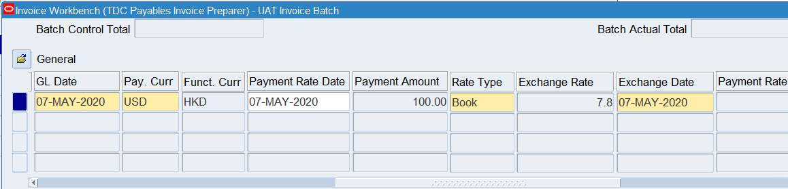
Create Invoice
Create Direct Invoice (6/11)
Scroll to the right.
If you entered a foreign currency invoice, the Rate Type will be defaulted to “Corporate” (book rate). Select the “User” rate type to manually specify an exchange rate for this invoice.
15

Slide 15
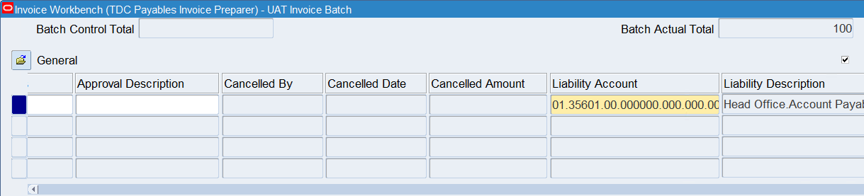
Create Invoice
Create Direct Invoice (7/11)
Scroll to the right.
Enter the Liability Account. The fund source segment of the liability account will be automatically changed to matched the invoice expense distributions when transferring the journal entries to GL.
16

Slide 16
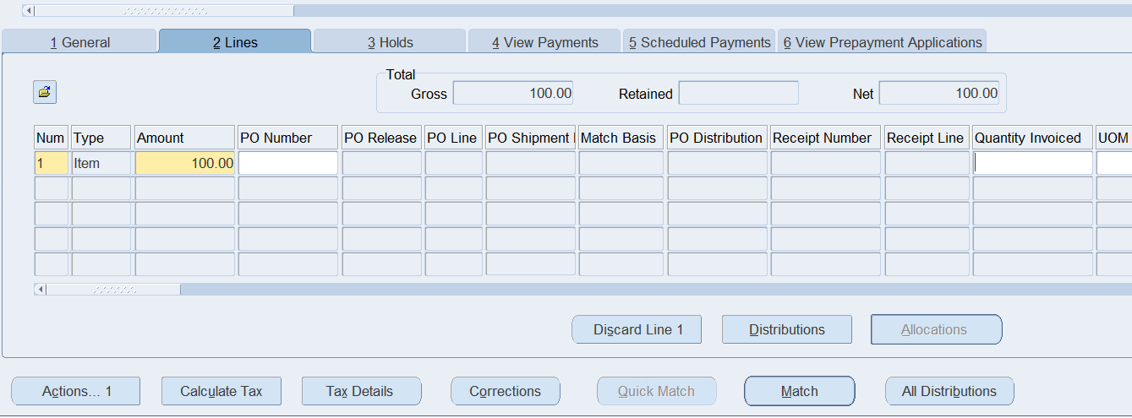
Create Invoice
Create Direct Invoice (8/11)
Scroll to the right.
Select any field of the invoice and click the “Lines” tab
Enter the invoice line amount.
Optionally enter the “Quantity Invoiced”
Click “Distributions”
17
18
19
20

Slide 17
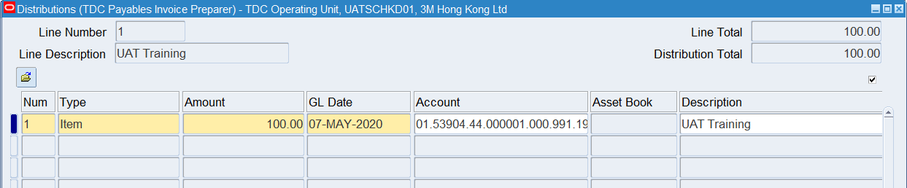
Create Invoice
Create Direct Invoice (9/11)
Enter the invoice distribution line amount.
Override the GL Date defaulted from the invoice header & line if appropriate.
For non-project related transactions, Enter the invoice charge distribution account. For project related transactions, leave the invoice charge distribution account blank.
Override the distribution line description defaulted from the line description if appropriate.
22
23
21
24

Slide 18
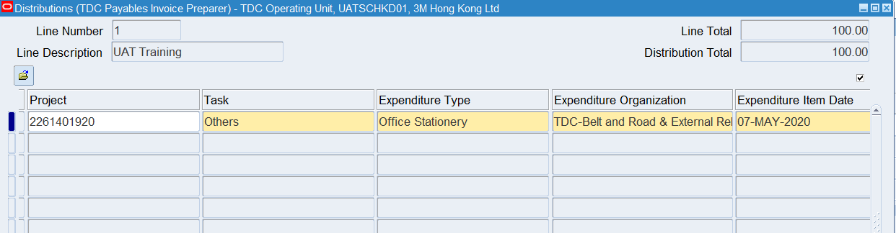
Create Invoice
Create Direct Invoice (10/11)
For project related transactions, select “Project” number and the following project attributes
Select the “Task” number
Select the “Expenditure Type”
Select the “Expenditure Organization”
Save the distribution, the invoice charge distribution account will be generated automatically
Note: The project attributes entered should match the nature, project activity, sub-activity, activity-location and analysis codes of the account entered.
26
27
28
29
25

Slide 19
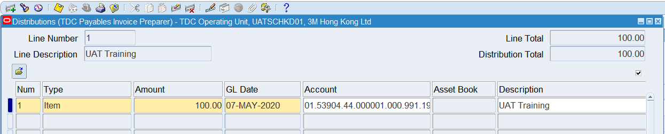
Create Invoice
Create Direct Invoice (11/11)
(Optional) If additional distribution line is needed, click the “Add Record” icon and then repeat step (9) and (10) on the new distribution line.
Otherwise, save the record.
Close the Distributions form
30
31
32

Slide 20
Create Invoice
Create PO Invoice

Slide 21
Create Invoice
Create PO Invoice (1/12)
Responsibility:
TDC Payables Invoice Preparer
TDC Payables Invoice Preparer (ES)
TDC Payables Invoice Preparer (JBCC)
Invoices > Entry > Invoice Batches
1

Slide 22
Create Invoice
Create PO Invoice (2/12)
Create/ Search an invoice batch.
Click Invoices
2
3

Slide 23
Create Invoice
Create PO Invoice (3/12)
Click “Add Record” icon to add another invoice (If there is no existing invoice in the invoice batch, skip the following tasks and directly perform tasks in Step (7).
4
Click “Folder” and select “General”
Click “Ok
5
6

Slide 24
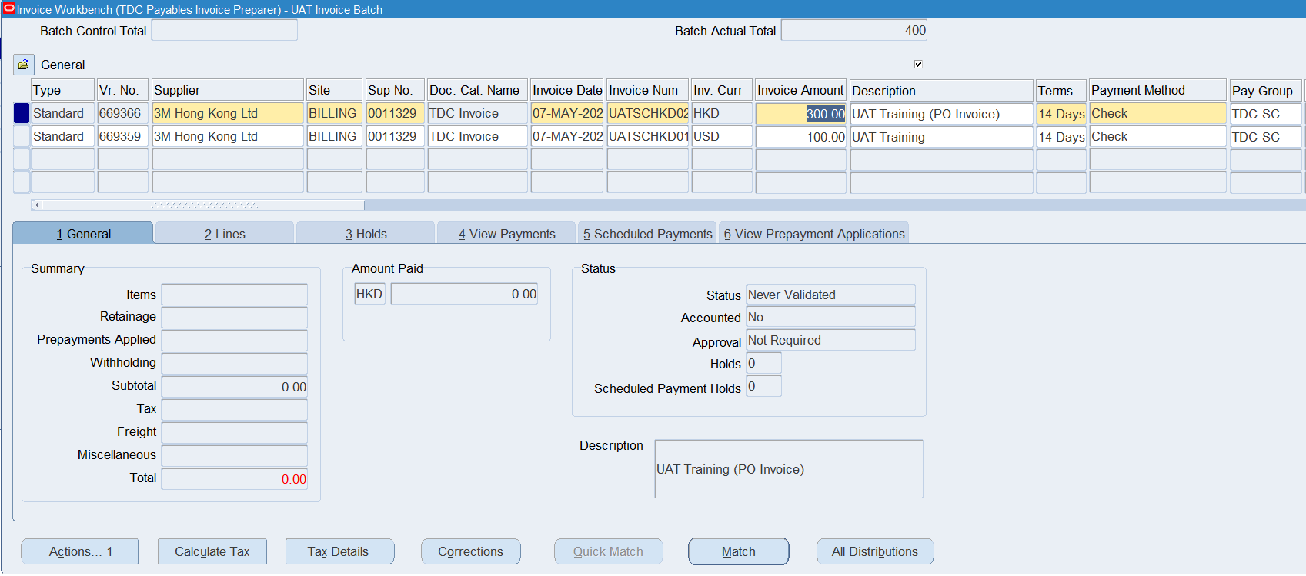
Create Invoice
Create PO Invoice (4/12)
Complete the invoice information following the steps in “Create Direct Invoice” section
Click “Match”
7
8

Slide 25
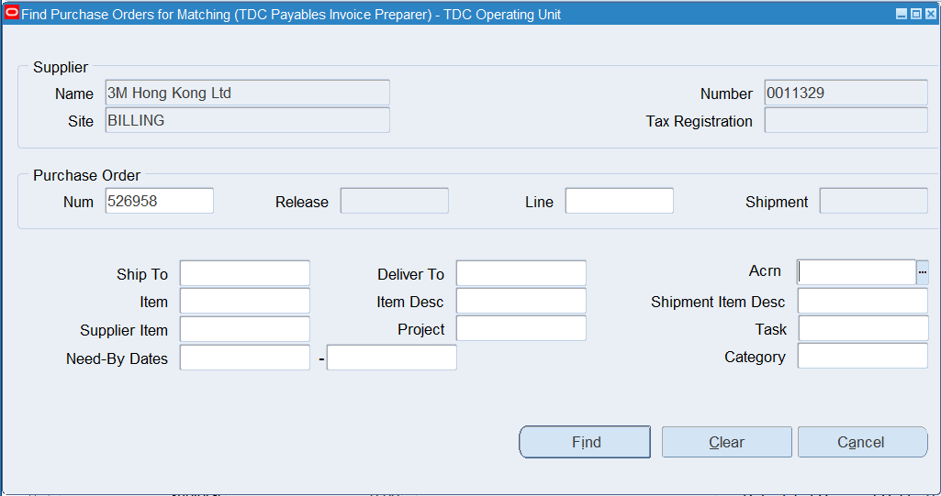
Create Invoice
Create PO Invoice (5/12)
Enter any search criteria to find the PO to be matched.
Click “Find”.
9
10

Slide 26
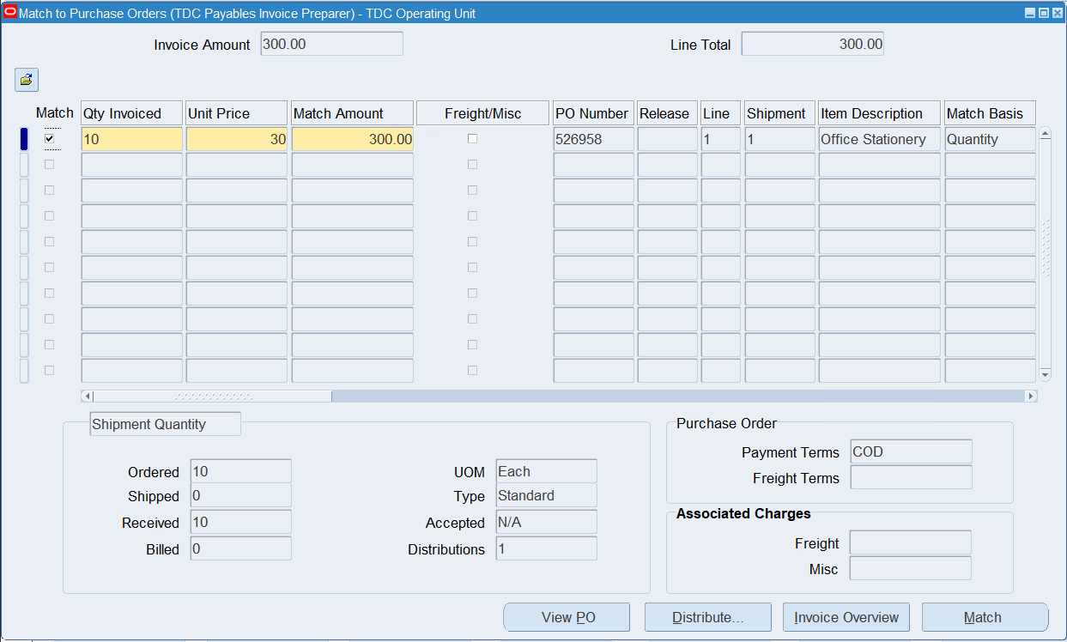
Create Invoice
Create PO Invoice (6/12)
Check the “Match” option checkbox of the to-be-matched PO Shipment Line.
Change the value of the matching quantity if the default value is not suitable.
(To match the PO on shipment level) Click the “Match” button after matching information is confirmed and skip the steps on the next slide.
(To match the PO on distribution level) Click the “Distribute…” button
12
11
14
13

Slide 27
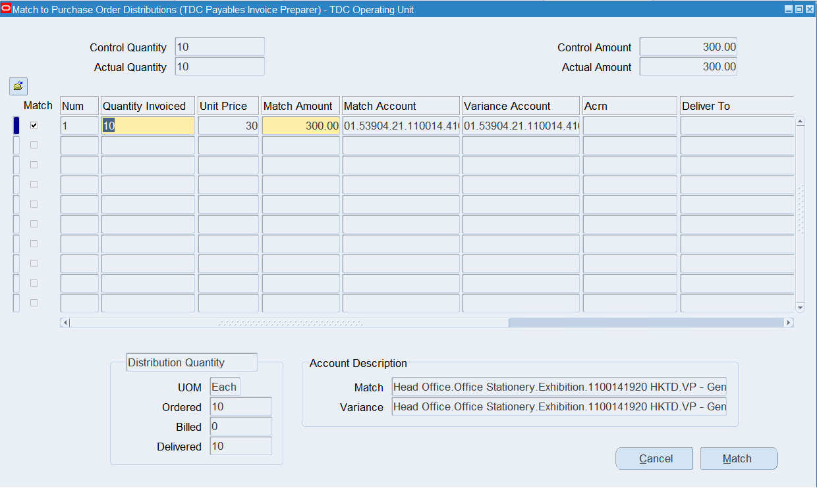
Create Invoice
Create PO Invoice (7/12)
(To match the PO on distribution level) Check the “Match” option checkbox of the to-be-matched PO Distribution Line.
(To match the PO on distribution level) Enter the value of the matching quantity.
(To match the PO on distribution level) Click the “Match” button after matching information is confirmed.
16
15
17

Slide 28
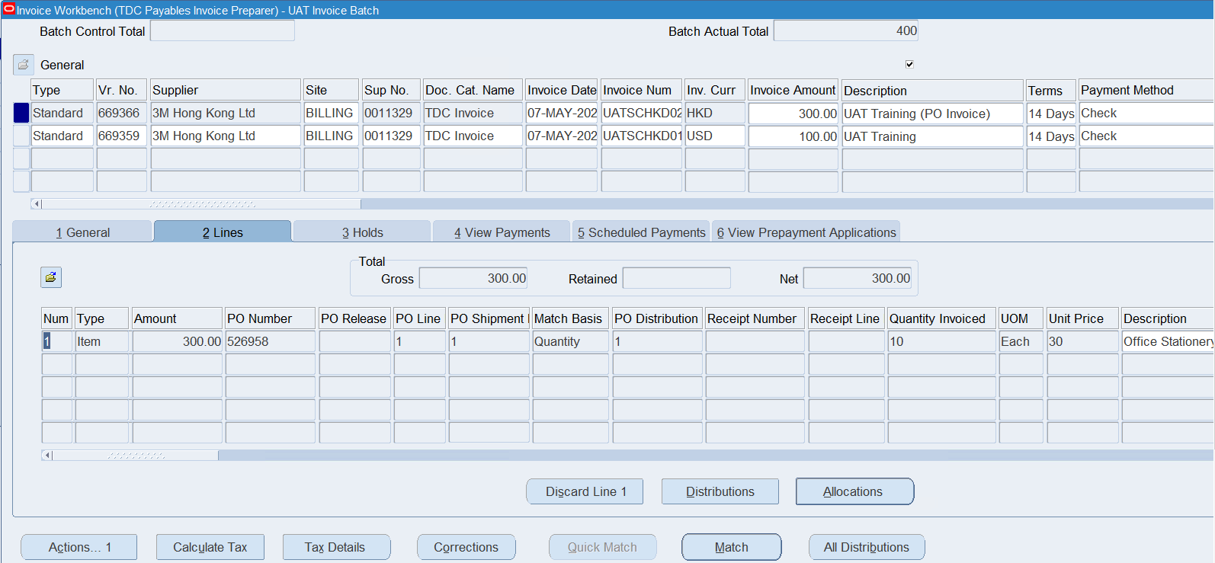
Create Invoice
Create PO Invoice (8/12)
Click on the invoice line record just created by the matching.
Click the “Distributions” button.
18
19

Slide 29
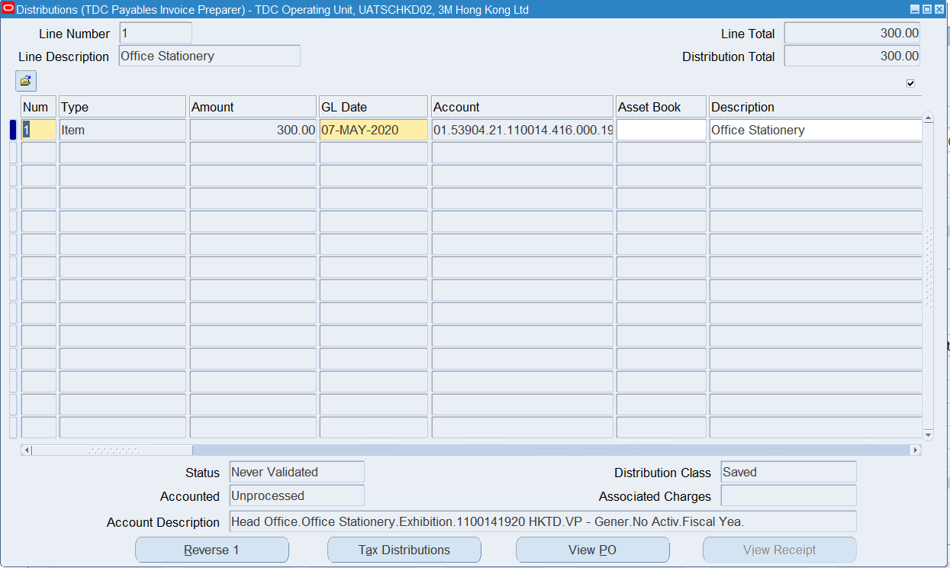
Create Invoice
Create PO Invoice (9/12)
Review the distribution information and scroll to the right

Slide 30
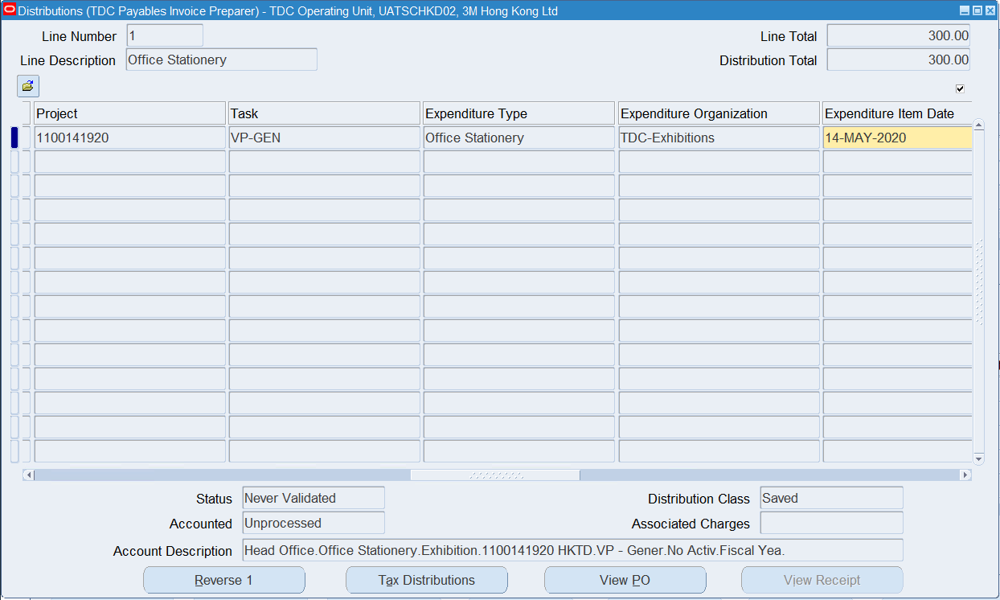
Create Invoice
Create PO Invoice (10/12)
Project attributes are derived from the matched PO

Slide 31
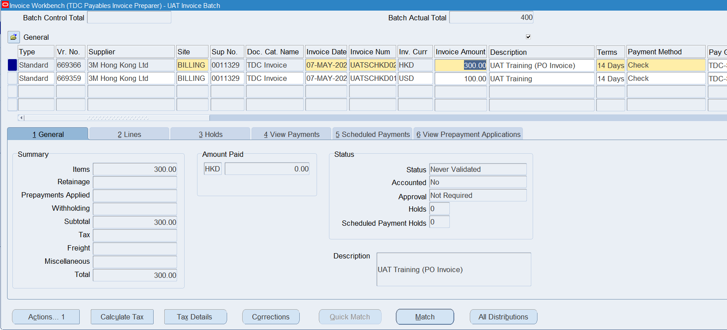
Create Invoice
Create PO Invoice (11/12)
If there is no need to match another PO to this invoice, skip the following steps.
Click on the invoice record to select the invoice for matching.
Change the Invoice Amount if it is required.
Click the “Match” button.
21
20
22

Slide 32
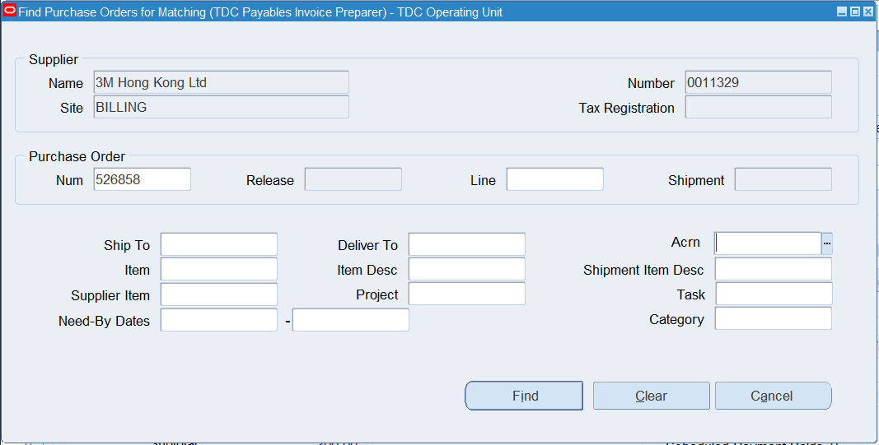
Create Invoice
Create PO Invoice (12/12)
Enter Another PO No. in the “Num” field of Purchase Order section.
Click the “Find” button.
Repeat the steps on steps 5 to 7 to match the PO.
23
24

Slide 33

Q&A
Oracle EPM Implementation Proposal
33

Slide 34
About Deloitte Global Deloitte refers to one or more of Deloitte Touche Tohmatsu Limited, a UK private company limited by guarantee (“DTTL”), its network of member firms, and their related entities. DTTL and each of its member firms are legally separate and independent entities. DTTL (also referred to as “Deloitte Global”) does not provide services to clients. Please see www.deloitte.com/about to learn more about our global network of member firms.
Deloitte provides audit & assurance, consulting, financial advisory, risk advisory, tax and related services to public and private clients spanning multiple industries. Deloitte serves over 80 percent of the Fortune Global 500® companies through a globally connected network of member firms in more than 150 countries and territories bringing world-class capabilities, insights, and high-quality service to address clients’ most complex business challenges. To learn more about how Deloitte’s approximately 286,000 professionals make an impact that matters, please connect with us on Facebook, LinkedIn, or Twitter.
About Deloitte China The Deloitte brand first came to China in 1917 when a Deloitte office was opened in Shanghai. Now the Deloitte China network of firms, backed by the global Deloitte network, deliver a full range of audit & assurance, consulting, financial advisory, risk advisory and tax services to local, multinational and growth enterprise clients in China. We have considerable experience in China and have been a significant contributor to the development of China's accounting standards, taxation system and local professional accountants. To learn more about how Deloitte makes an impact that matters in the China marketplace, please connect with our Deloitte China social media platforms via www2.deloitte.com/cn/en/social-media.
This communication contains general information only, and none of Deloitte Touche Tohmatsu Limited, its member firms, or their related entities (collectively the “Deloitte Network”) is by means of this communication, rendering professional advice or services. Before making any decision or taking any action that may affect your finances or your business, you should consult a qualified professional adviser. No entity in the Deloitte Network shall be responsible for any loss whatsoever sustained by any person who relies on this communication.
© 2020. For information, contact Deloitte China.

